Slide 1

MC9510- Modelling in Operations Research Markov process
T. Mayooran,
Department of Interdisciplinary Studies,
Faculty of Engineering,
University of Jaffna.
Email: mayooran@eng.jfn.ac.lk

Slide 2
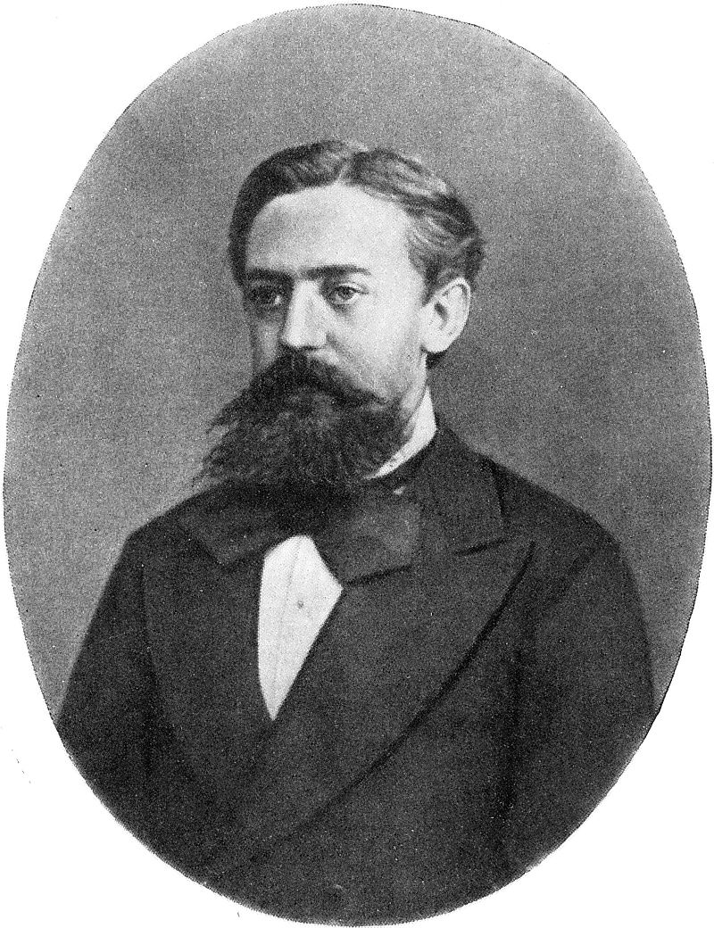
History
Markov studied Markov processes in the early 20th century, publishing his first paper on the topic in 1906.
Markov processes in continuous time were discovered long before Andrey Markov's work in the early 20th century, the form of the Poisson process.
Markov was interested in studying an extension of independent random sequences, motivated by a disagreement with Pavel Nekrasov who claimed independence was necessary for the weak law of large numbers to hold.

Slide 3
A Markov process is a stochastic process that satisfies the Markov property (sometimes characterised as "memorylessness").
In simpler terms, a Markov process is a process for which one can make predictions for the future based solely on its present state just as well as one could knowing the process's full history. In other words, conditional on the present state of the system, its future and past states are independent.

Slide 4
Markov Process
• Markov Property: The state of the system at time t+1 depends only on the state of the system at time t
X₁
X₂
X₃
X₄
X₅
•Stationary Assumption: Transition probabilities are independent of time (t)
Bounded memory transition model

Slide 5
Markov Process Simple Example
Weather:
raining today 40% rain tomorrow
60% no rain tomorrow
not raining today 20% rain tomorrow
80% no rain tomorrow
Stochastic FSM:
0.4
0.6
0.8
rain
no rain
0.2
*finite-state machine - FSM

Slide 6
Markov Process Simple Example
Weather:
raining today 40% rain tomorrow
60% no rain tomorrow
not raining today 20% rain tomorrow
80% no rain tomorrow
The transition matrix:
Stochastic matrix:
Rows sum up to 1
Double stochastic matrix:
Rows and columns sum up to 1

Slide 7
Markov Process Gambler’s Example
– Gambler starts with $10
- At each play we have one of the following:
• Gambler wins $1 with probability p
• Gambler looses $1 with probability 1-p
– Game ends when gambler goes broke, or gains a fortune of $100
(Both 0 and 100 are absorbing states)
p
p
p
p
0
1
2
99
100
1-p
Start (10$)
1-p
1-p
1-p

Slide 8
Markov Process
Markov process - described by a stochastic FSM
Markov chain - a random walk on this graph
(distribution over paths)
Edge-weights give us
We can ask more complex questions, like
p
p
p
p
0
1
2
99
100
1-p
Start (10$)
1-p
1-p
1-p

Slide 9
Markov Process Coke vs. Pepsi Example
Given that a person’s last cola purchase was Coke, there is a 90% chance that his next cola purchase will also be Coke.
If a person’s last cola purchase was Pepsi, there is an 80% chance that his next cola purchase will also be Pepsi.
transition matrix:
0.1
0.9
0.8
coke
pepsi
0.2

Slide 10
Markov Process Coke vs. Pepsi Example (cont)
Given that a person is currently a Pepsi purchaser, what is the probability that he will purchase Coke two purchases from now?
Pr[ Pepsi→?→Coke ] =
Pr[ Pepsi→Coke→Coke ] + Pr[ Pepsi→ Pepsi →Coke ] =
0.2 * 0.9 + 0.8 * 0.2 = 0.34
Pepsi → ?
? → Coke

Slide 11
Markov Process Coke vs. Pepsi Example (cont)
Given that a person is currently a Coke purchaser, what is the probability that he will purchase Pepsi three purchases from now?

Slide 12
Markov Process Coke vs. Pepsi Example (cont)
Assume each person makes one cola purchase per week
Suppose 60% of all people now drink Coke, and 40% drink Pepsi
What fraction of people will be drinking Coke three weeks from now?
Pr[X₃=Coke] = 0.6 * 0.781 + 0.4 * 0.438 = 0.6438
Q_{i} - the distribution in week i
Q₀=(0.6,0.4) - initial distribution
Q₃= Q₀ * P³ =(0.6438,0.3562)

Slide 13
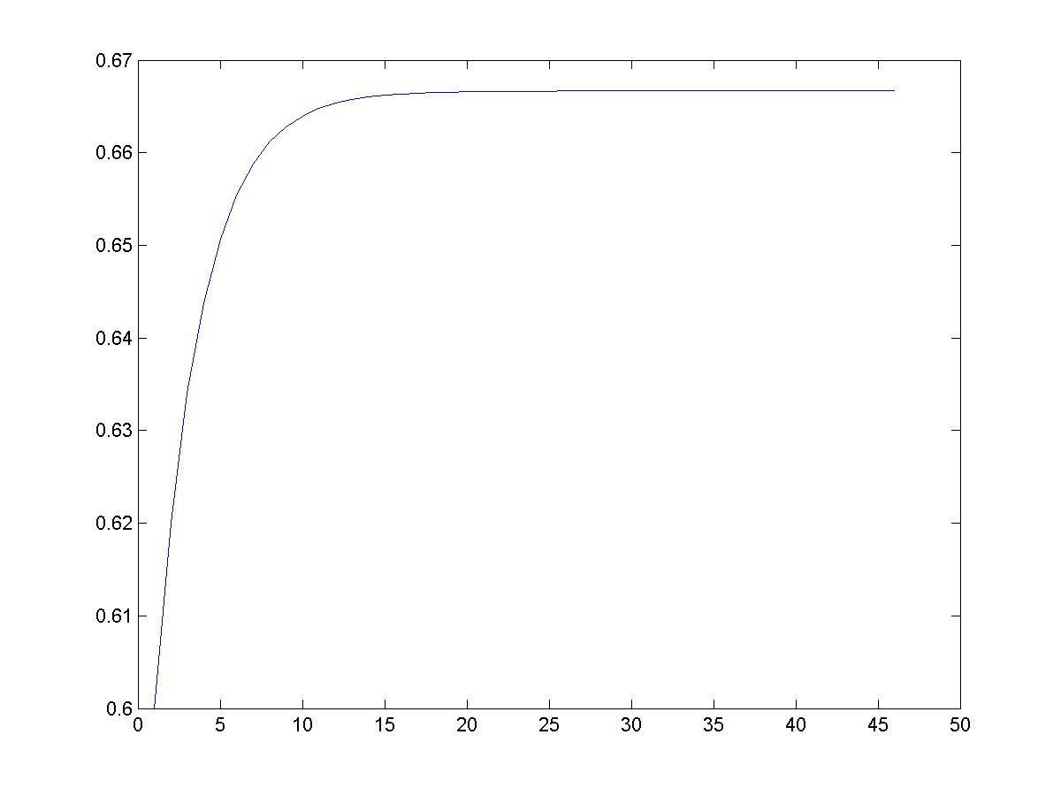
Markov Process Coke vs. Pepsi Example (cont)
Simulation:
2/3
Pr[X_{i} = Coke]
stationary distribution
0.9
0.1
0.8
coke
pepsi
0.2
week - i

Slide 14
Markov Chain Definition
A stochastic process { X_{n} } is called a Markov chain if
Pr{ X_{n+1} = j | X₀ = k₀, . . . , X_{n-1} = k_{n-1}, X_{n} = i }
= Pr{ X_{n+1} = j | X_{n} = i } ← transition probabilities
for every i, j, k₀, . . . , k_{n-1} and for every n.
Discrete-time means n ∈ N = { 0, 1, 2, . . . }.
The system’s future behaviour depends only on the current state i and not any previous states.

Slide 15
Stationary Transition Probabilities
Pr{ X_{n+1} = j | X_{n} = i } = Pr{ X₁ = j | X₀ = i } for all n
(They don’t change over time)
We will only consider stationary Markov chains.
The one-step transition matrix for a Markov chain
with states S = { 0, 1, 2 } is
where p_{ij} = Pr{ X₁ = j | X₀ = i }

Slide 16
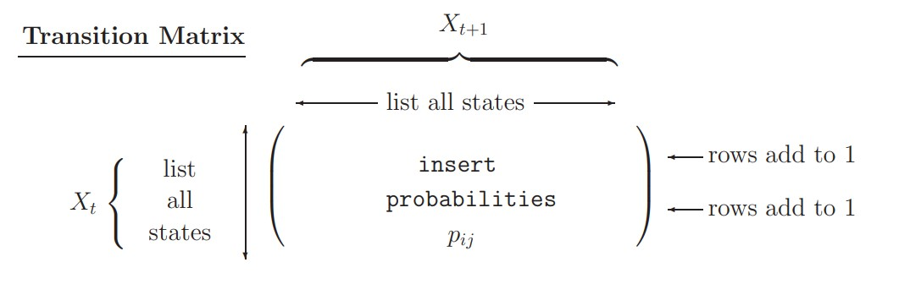
Properties of Transition Matrix
If the state space S = { 0, 1, . . . , m –1} then we have
∑_{j} p_{ij} = 1 ∀ i and p_{ij} ≥ 0 ∀ i, j
(we must (each transition
go somewhere) has probability ≥ 0)

Slide 17
Brand Switching Example
Number of consumers switching from brand i in week 26 to brand j in week 27
Brand | (j) 1 | 2 | 3 | Total
(i)
1 | 90 | 7 | 3 | 100
2 | 5 | 205 | 40 | 250
3 | 30 | 18 | 102 | 150
Total | 125 | 230 | 145 | 500
This is called a contingency table.
→ Used to construct transition probabilities.

Slide 18
Empirical Transition Probabilities for Brand Switching, p_{ij}
Brand | (j) 1 | 2 | 3
(i)
1
2
3
Steady state →

Slide 19
Transition Probabilities for n Steps
Property 1:
Let {X_{n} : n = 0, 1, . . .} be a Markov chain with state space S and state-transition matrix P. Then for i and j ∈ S, and n = 1, 2, . . .
Pr{X_{n} = j | X₀ = i} = p_{ij}
where the right-hand side represents the ij^{th} element of the matrix P^{(n)}.
^{(n)}

Slide 20
Practice Problem
Ramesh is in jail and has 3 dollars; he can get out on bail if he has 8 dollars. A guard agrees to make a series of bets with him. If Ramesh bets A dollars, he wins A dollars with a probability of 0.4 and loses A dollars with a probability of 0.6. Draw the transition diagram and transition matrix for this problem.

Slide 21
Practice Problem
Assume that a man’s profession can be classified as professional, skilled labourer, or unskilled labourer. Assume that, of the sons of professional men, 80 percent are professional, 10 percent are skilled labourers, and 10 percent are unskilled labourers. In the case of sons of skilled labourers, 60 percent are skilled labourers, 20 percent are professional, and 20 percent are unskilled. Finally, in the case of unskilled labourers, 50 percent of the sons are unskilled labourers, and 25 percent each are in the other two categories. Assume that every man has at least one son, and form a Markov chain by following the profession of a randomly chosen son of a given family through several generations. Set up the matrix of transition probabilities. Find the probability that a randomly chosen grandson of an unskilled labourer is a professional man.

Slide 22

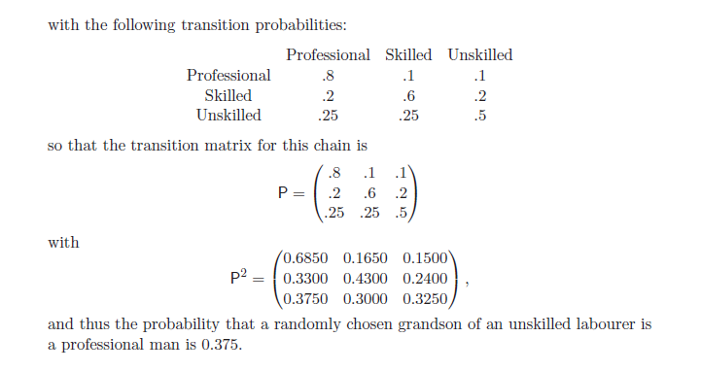

Slide 23
Steady-State Probabilities
Property 2: Let π = (π₁, π₂, . . . , π_{m}) is the m-dimensional row vector of steady-state (unconditional) probabilities for the state space S = {1,…,m}. To find steady-state probabilities, solve linear system:
π = πP, Σ_{j=1,m} π_{j} = 1, π_{j} ≥ 0, j = 1,…,m
Brand switching example:
π₁ + π₂ + π₂ = 1, π₁ ≥ 0, π₂ ≥ 0, π₃ ≥ 0

Slide 24
Steady-State Equations for Brand Switching Example
π₁ = 0.90π₁ + 0.02π₂ + 0.20π₃
π₂ = 0.07π₁ + 0.82π₂ + 0.12π₃
π₃ = 0.03π₁ + 0.16π₂ + 0.68π₃
π₁ + π₂ + π₃ = 1
π₁ ≥ 0, π₂ ≥ 0, π₃ ≥ 0
Total of 4 equations in 3 unknowns
➔ Discard 3rd equation and solve the remaining system to get :
π₁ = 0.474, π₂ = 0.321, π₃ = 0.205

Slide 25
Existence of Steady-State Probabilities
A Markov chain is ergodic if it is aperiodic and allows the attainment of any future state from any initial state after one or more transitions. If these conditions hold, then
For example,
State-transition network
1
2
3
Conclusion: chain is ergodic.
 Craps

Slide 26
special cases of Markov chains:
Regular Markov chains:
A Markov chain is a regular Markov chain if some power of the transition matrix has only positive entries. That is if we define the (i, j) entry of P^{n} to be p^{n}_{ij} , then the Markov chain is regular if there is some n such that p^{n}_{ij}> 0 for all (i,j).
Absorbing Markov chains:
A state S_{k} of a Markov chain is called an absorbing state if, once the Markov chain enters the state, it remains there forever.
A Markov chain is called an absorbing chain if
It has at least one absorbing state.
For every state in the chain, the probability of reaching an absorbing state in a finite number of steps is nonzero.

Slide 27
Definition: A state si of a Markov chain is called absorbing if it is impossible to leave it (i.e., p_{ii} = 1). A Markov chain is absorbing if it has at least one absorbing state, and if from every state, it is possible to go to an absorbing state (not necessarily in one step).
Definition: In an absorbing Markov chain, a state which is not absorbing is called transient.

Slide 28
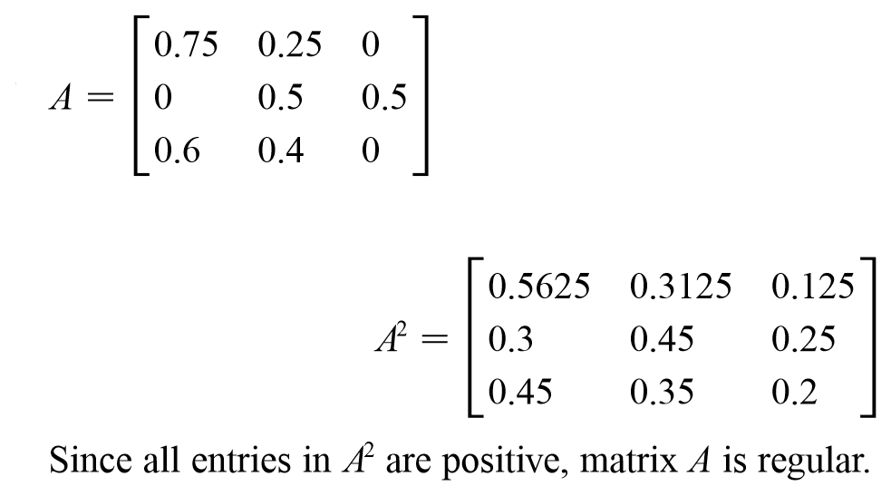
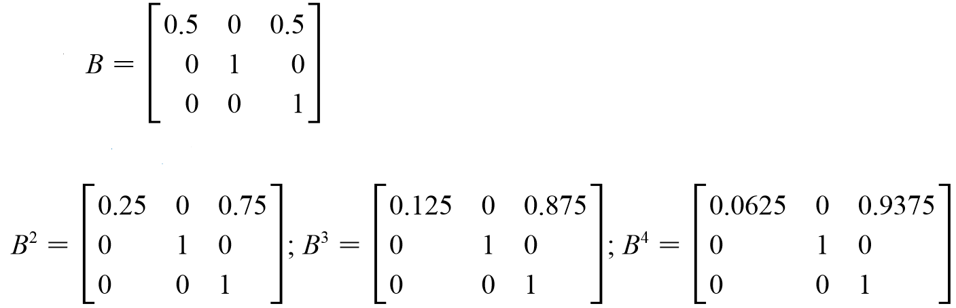
Examples:
Regular
Not regular

Slide 29
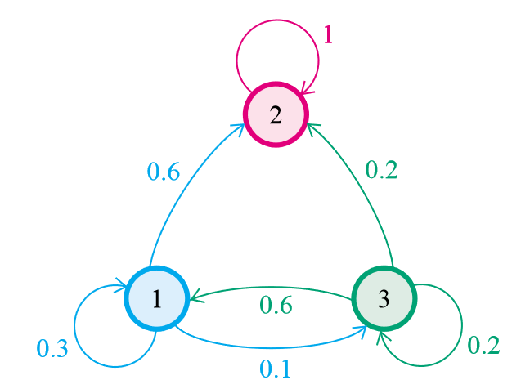
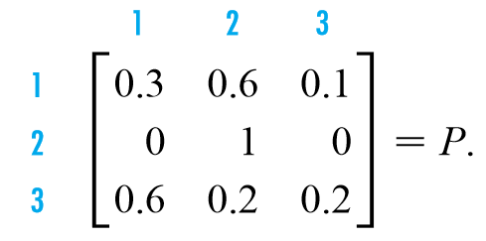
Examples : Absorbing
State 2 is absorbing
P_{ii} = 1 → P₂₂ = 1
http://www.math.bas.bg/~jeni/markov123.pdf

Slide 30
Irreducible Markov Chain:
A Markov chain is irreducible if all the states communicate with each other, i.e., if there is only one communication class.
i and j communicate if they are accessible from each other. This is written i↔j .

Slide 31
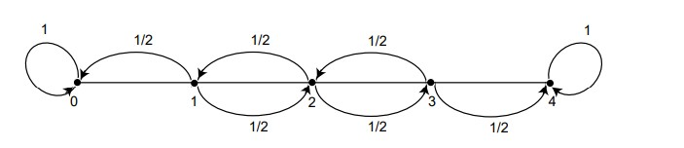
Practice problem (Drunkard’s Walk)
A man walks along a four-block stretch of Park Avenue (see Figure below). If he is at corners 1, 2, or 3, he walks to the left or right with equal probability. He continues until he reaches corner 4, a bar, or corner 0, his home. If he reaches either home or the bar, he stays there.
We can form a Markov chain with states 0, 1, 2, 3, and 4. States 0 and 4 are absorbing states. Find the transition matrix for this problem.

Slide 32
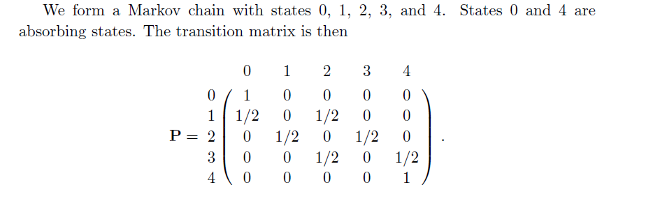

Slide 33
Can we answer these questions?
Refer previous example (Drunkard’s Walk)
What is the probability that the process will end up in a given absorbing state?
On average, how long will it take for the process to be absorbed?
On average, how many times will the process be in each transient state?

Slide 34
Canonical Form and Fundamental Matrix

Slide 35
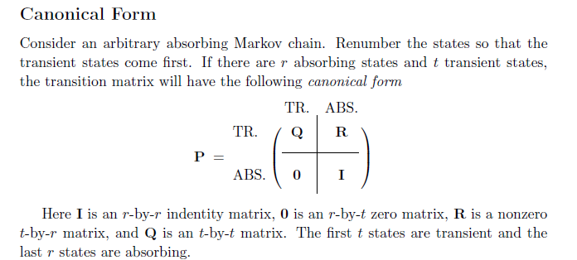

Slide 36
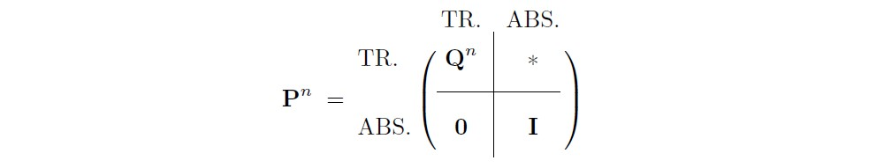
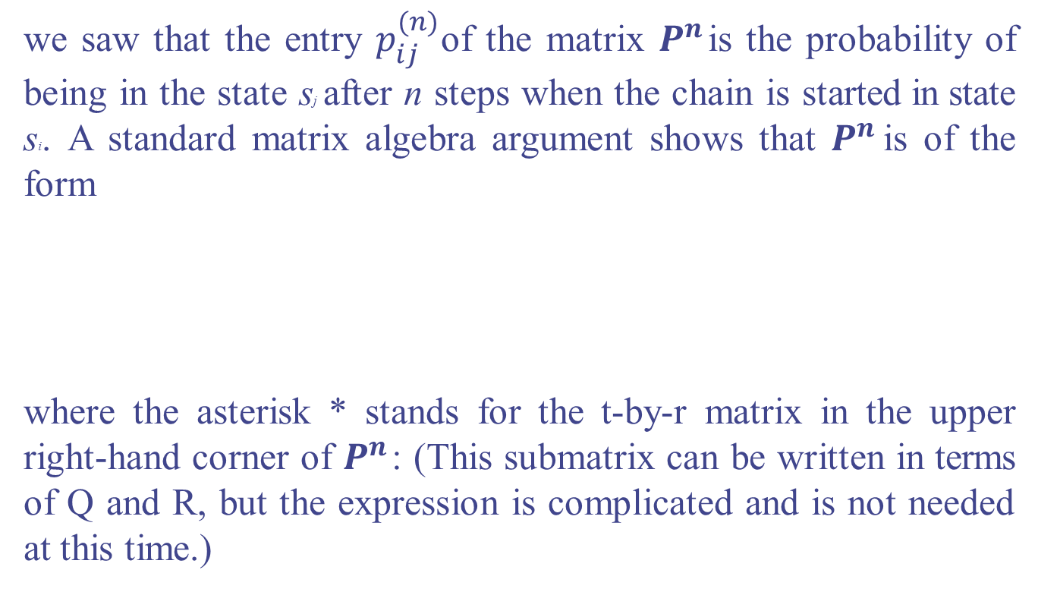
we saw that the entry $p_{ij}^{(n)}$of the matrix $P^{n}$ is the probability of being in the state sj after n steps when the chain is started in state si. A standard matrix algebra argument shows that $P^{n}$ is of the form
where the asterisk * stands for the t-by-r matrix in the upper right-hand corner of $P^{n}$ : (This submatrix can be written in terms of Q and R, but the expression is complicated and is not needed at this time.)

Slide 37
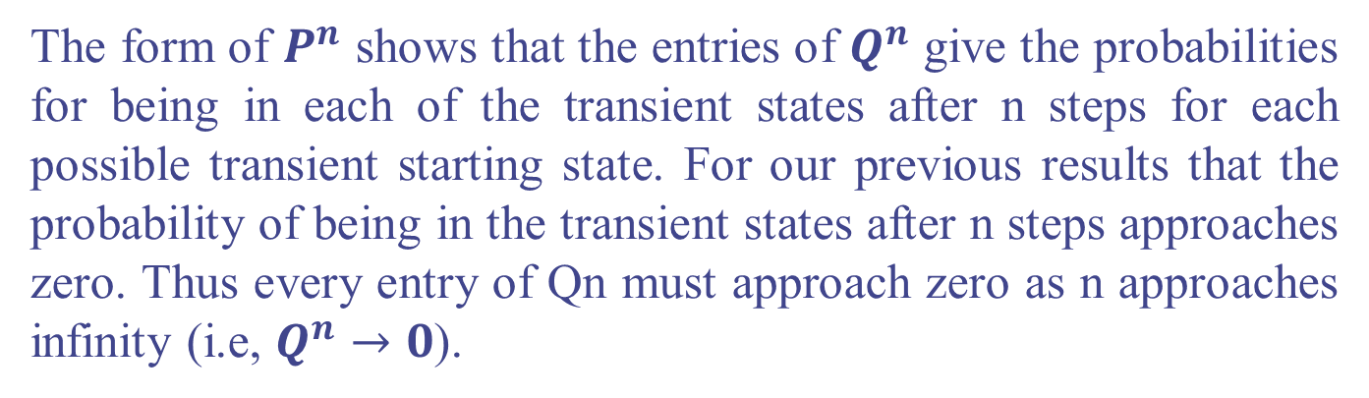
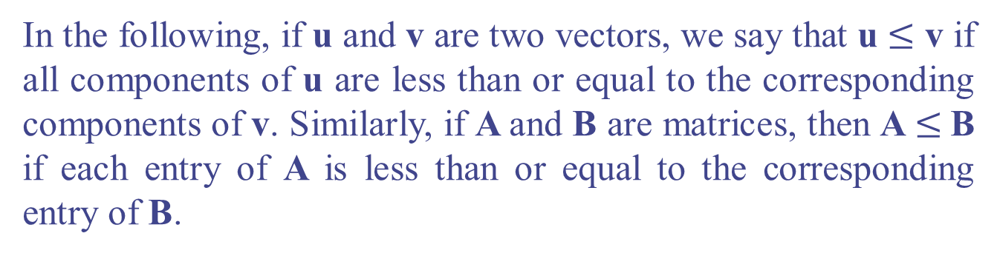
The form of $P^{n}$ shows that the entries of $Q^{n}$ give the probabilities for being in each of the transient states after n steps for each possible transient starting state. For our previous results that the probability of being in the transient states after n steps approaches zero. Thus every entry of Qn must approach zero as n approaches infinity (i.e, $Q^{n}→0$).
In the following, if u and v are two vectors, we say that u $≤$ v if all components of u are less than or equal to the corresponding components of v. Similarly, if A and B are matrices, then A $≤$B if each entry of A is less than or equal to the corresponding entry of B.

Slide 38
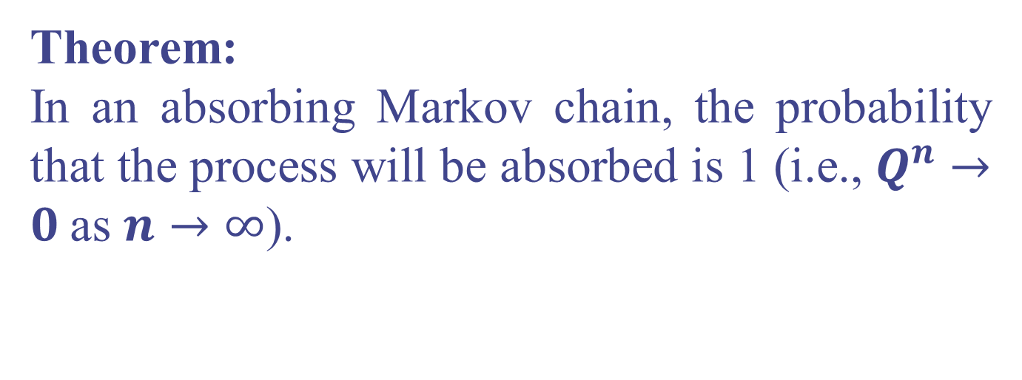
Probability of Absorption
Theorem:
In an absorbing Markov chain, the probability that the process will be absorbed is 1 (i.e., $Q^{n}→0$as $n→∞$).

Slide 39
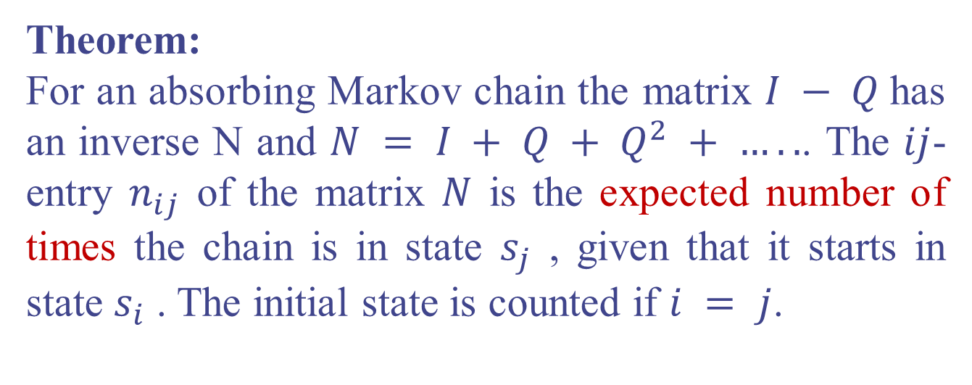
The Fundamental Matrix
Theorem:
For an absorbing Markov chain the matrix $I − Q$has an inverse N and $N = I + Q + Q^{2} + …..$. The $ij$-entry $n_{ij}$ of the matrix $N$ is the expected number of times the chain is in state $s_{j}$ , given that it starts in state $s_{i}$ . The initial state is counted if $i = j$.

Slide 40
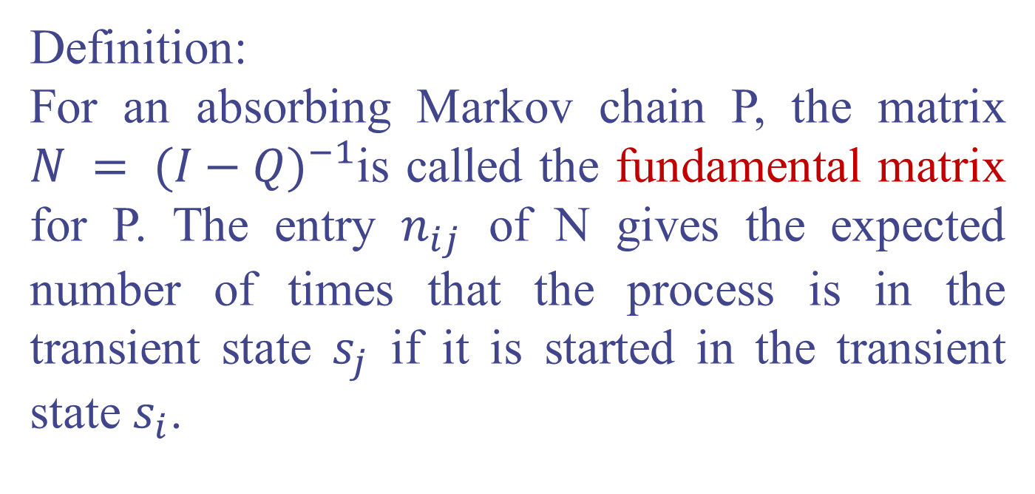
Definition:
For an absorbing Markov chain P, the matrix $N = {(I−Q)}^{−1}$is called the fundamental matrix for P. The entry $n_{ij}$ of N gives the expected number of times that the process is in the transient state $s_{j}$ if it is started in the transient state $s_{i}$.

Slide 41
To find the Matrix inverse calculation, kindly check out the following webpage: http://graphics.ics.uci.edu/ICS6N/NewLectures/Lecture5.pdf.
Or
Please use your calculator directly!

Slide 42
Example
In the Drunkard's Walk example,
find the transition matrix in canonical form.
If we start in state 2, estimate the expected number of times in states 1, 2, and 3 before being absorbed.

Slide 43
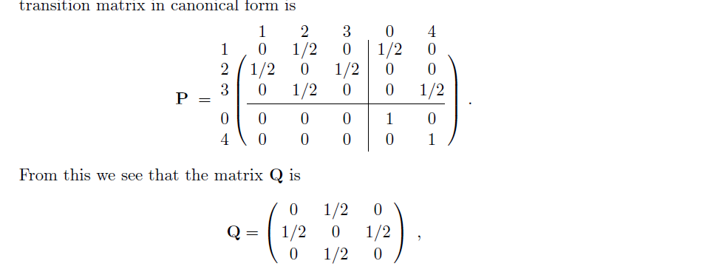

Slide 44
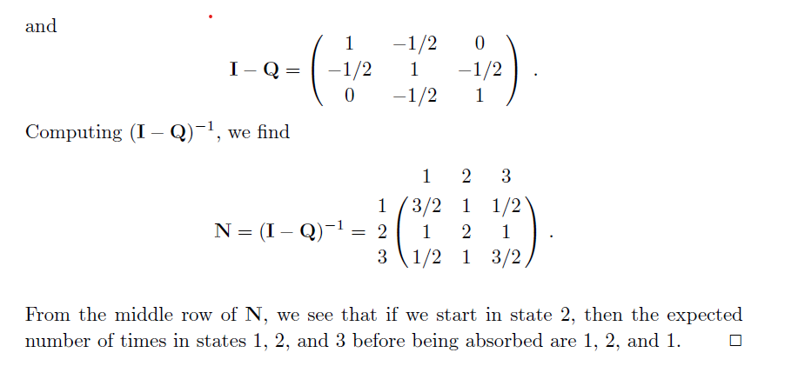

Slide 45
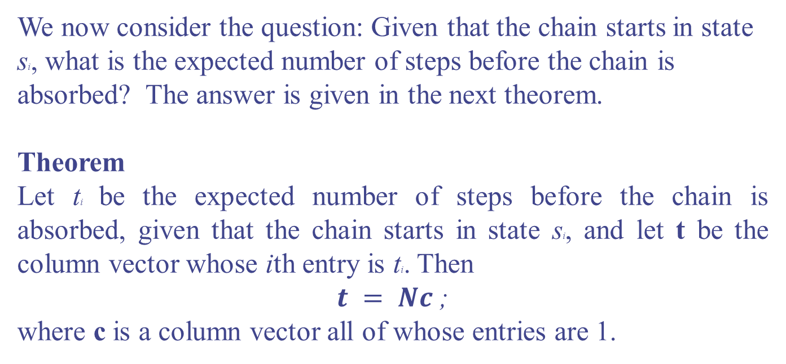
Time to Absorption
We now consider the question: Given that the chain starts in state si, what is the expected number of steps before the chain is absorbed? The answer is given in the next theorem.
Theorem
Let ti be the expected number of steps before the chain is absorbed, given that the chain starts in state si, and let t be the column vector whose ith entry is ti. Then
$t = Nc$;
where c is a column vector all of whose entries are 1.

Slide 46
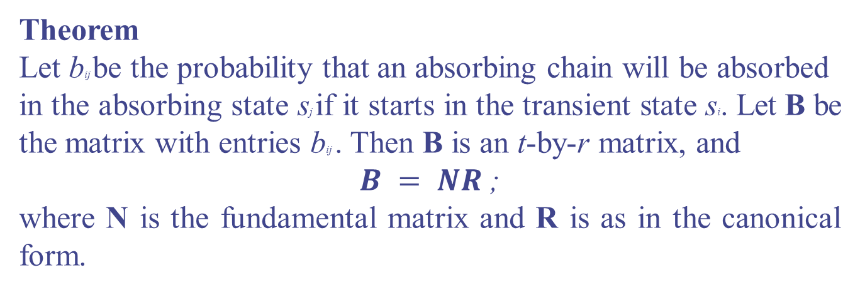
Absorption Probabilities
Theorem
Let bij be the probability that an absorbing chain will be absorbed
in the absorbing state sj if it starts in the transient state si. Let B be the matrix with entries bij . Then B is an t-by-r matrix, and
$B = NR$;
where N is the fundamental matrix and R is as in the canonical form.

Slide 47
Example
In the Drunkard's Walk example, find
Proofs that starting in states 1, 2, and 3, the expected times to absorption are 3, 4, and 3, respectively.
Show that starting from state 1, there is a probability 3/4 of absorption in state 0 and 1/4 of absorption in state 4.

Slide 48
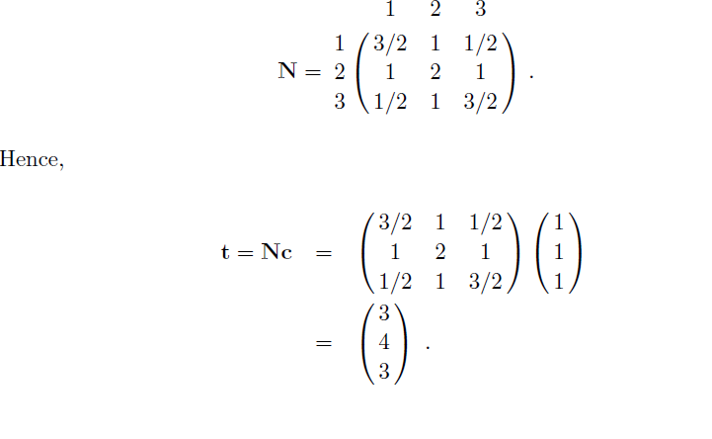

Slide 49
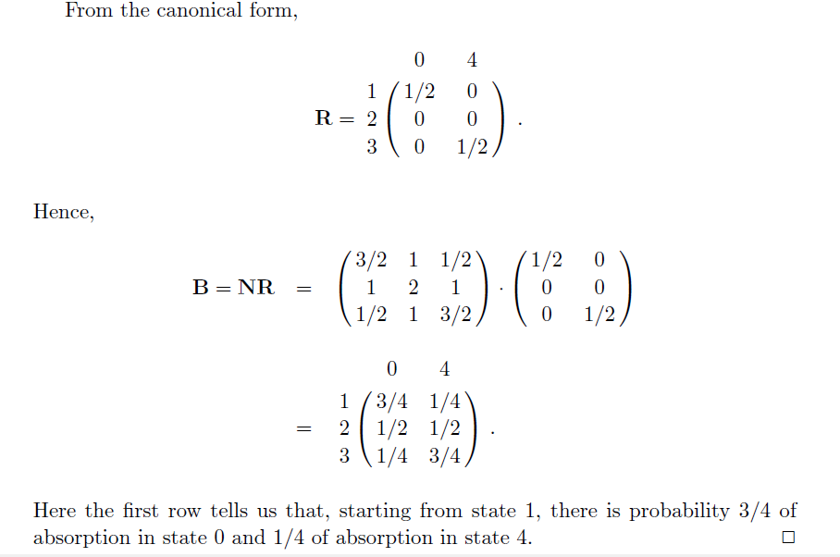

Slide 50
Practice Problem!
Consider a complex engineering system consisting of three components: A, B, and C. The system can be in one of four states: "working state" (W), "component A failure" (FA), "component B failure" (FB), or "component C failure" (FC). The system can transition between these states with the following probabilities in one time step: The probability of transitioning from the "working state" (W) to the "working state" (W) is 0.8. The probability of transitioning from the "working state" (W) to "component A failure" (FA) is 0.1. The probability of transitioning from the "working state" (W) to "component B failure" (FB) is 0.05. The probability of transitioning from the "working state" (W) to "component C failure" (FC) is 0.05. The probability of transitioning from "component A failure" (FA) to "component A failure" (FA) is 0.6. The probability of transitioning from "component A failure" (FA) to "component C failure" (FC) is 0.1. The probability of transitioning from "component B failure" (FB) to "component B failure" (FB) is 0.7. The probability of transitioning from "component B failure" (FB) to "component C failure" (FC) is 0.3. The probability of transitioning from "component C failure" (FC) to "component C failure" (FC) is 1.0.

Slide 51
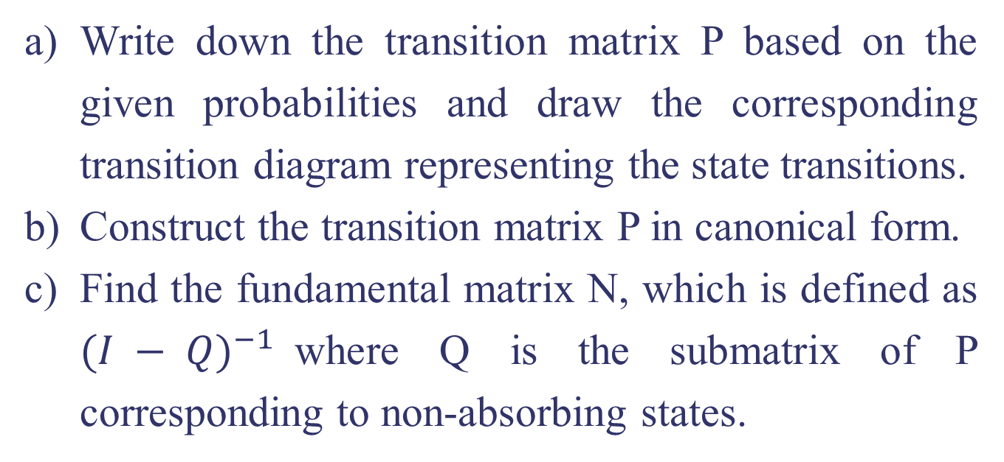
Write down the transition matrix P based on the given probabilities and draw the corresponding transition diagram representing the state transitions.
Construct the transition matrix P in canonical form.
Find the fundamental matrix N, which is defined as ${(I − Q)}^{−1}$where Q is the submatrix of P corresponding to non-absorbing states.
A problem quite akin to the one before (Drunkard's Walk example)! Give it a go on your own!

Slide 52
Practice Problem!
The city is served by two cable TV companies, BestTV and CableCast. Due to their aggressive sales tactics, each year, 40% of BestTV customers switch to CableCast; the other 60% of BestTV customers stay with BestTV. On the other hand, 30% of CableCast customers switch to Best TV. The two states in this example are BestTV and CableCast.
Express the above information as a transition matrix and transition diagram that displays the probabilities of going from one state to another.
Suppose that today 1/4 of customers subscribe to BestTV and 3/4 of customers subscribe to CableCast. After 1 year, what percent subscribe to each company?
Suppose instead that today, 80% of customers subscribe to BestTV and 20% subscribe to CableCast. After 1 year, what percent subscribe to each company?
To get solutions, please check out following link
https://math.libretexts.org/Bookshelves/Applied_Mathematics/Applied_Finite_Mathematics_(Sekhon_and_Bloom)/10%3A_Markov_Chains/10.01%3A_Introduction_to_Markov_Chains

Slide 53
Practice Problem!
In the Faculty of Science at the University of Jaffna, undergraduate students progress through three academic levels, namely Level 1, Level 2, and Level 3. As they navigate their academic journey, students follow specific transition probabilities that dictate their movement between these levels over one academic term, equivalent to two semesters. However, once a student reaches either the "Graduated" (G) or "Dropped Out" (D) state, they no longer transition to any other academic level. The probabilities of students transitioning between academic levels in one academic term (two semesters) are as follows: 70% of students in Level 1 are expected to remain in Level 1 for the next term, while 25% have a probability of moving to Level 2, and 5% may drop out, and this corresponds to the probability of transitioning to the "Dropped Out" state. There are no direct transitions to "Graduated" or “Level 3" from Level 1. For Level 2 students, 15% are likely to return to Level 1, 60% may continue to Level 2, and 20% have a chance of advancing to Level 3. Similarly, there are no direct transitions to "Graduated" or "Dropped Out" from Level 2. In Level 3, 15% have a possibility of moving to Level 2, and 30% are expected to remain in Level 3. There is also a 55% chance of transitioning to the "Graduated" state directly from Level 3. For the "Graduated" state, students will remain in that state with a probability of 100%, meaning there are no transitions to other academic levels or dropping out. The "Dropped Out" state behaves similarly, with a probability of 100% of staying in that state and no transitions to other levels or graduation.

Slide 54
Construct transition matrix and draw the transition diagram of matrix P.
Determine whether the given transition matrix is in canonical form. If not, convert it into canonical form.
Calculate the fundamental matrix N for the given Markov chain.
Determine the expected number of academic terms (two semesters) until each transient academic level (Levels 1, 2, 3) becomes absorbed into the Graduated state (G) and never transitions out.
Find the probability that a student who starts at Level 1 will reach the Graduated state (G) within a given number of academic terms (two semesters) or less.
A problem quite akin to the one before (Drunkard's Walk example)! Give it a go on your own!

Slide 55
Important dates:
27-07-2023 Revisions and Tutorial Discussions – 01.00 pm to 01.55 pm.
28-07-2023 Assignment 3 Examination 11.05 am to 11.35 am.

Slide 56


Don’t hesitate to contact us if you have any questions about this course’s teaching contents. Also, don’t forget to check out the course page and Microsoft Team folder,
course page Link: https://mayooran1987.github.io/MC9510/
Course page’s QR code
Microsoft Team folder

